Slide 1
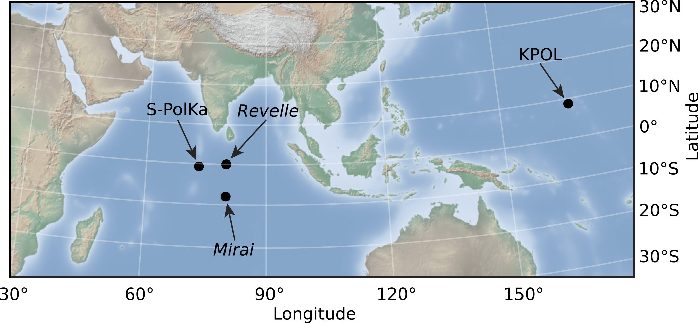
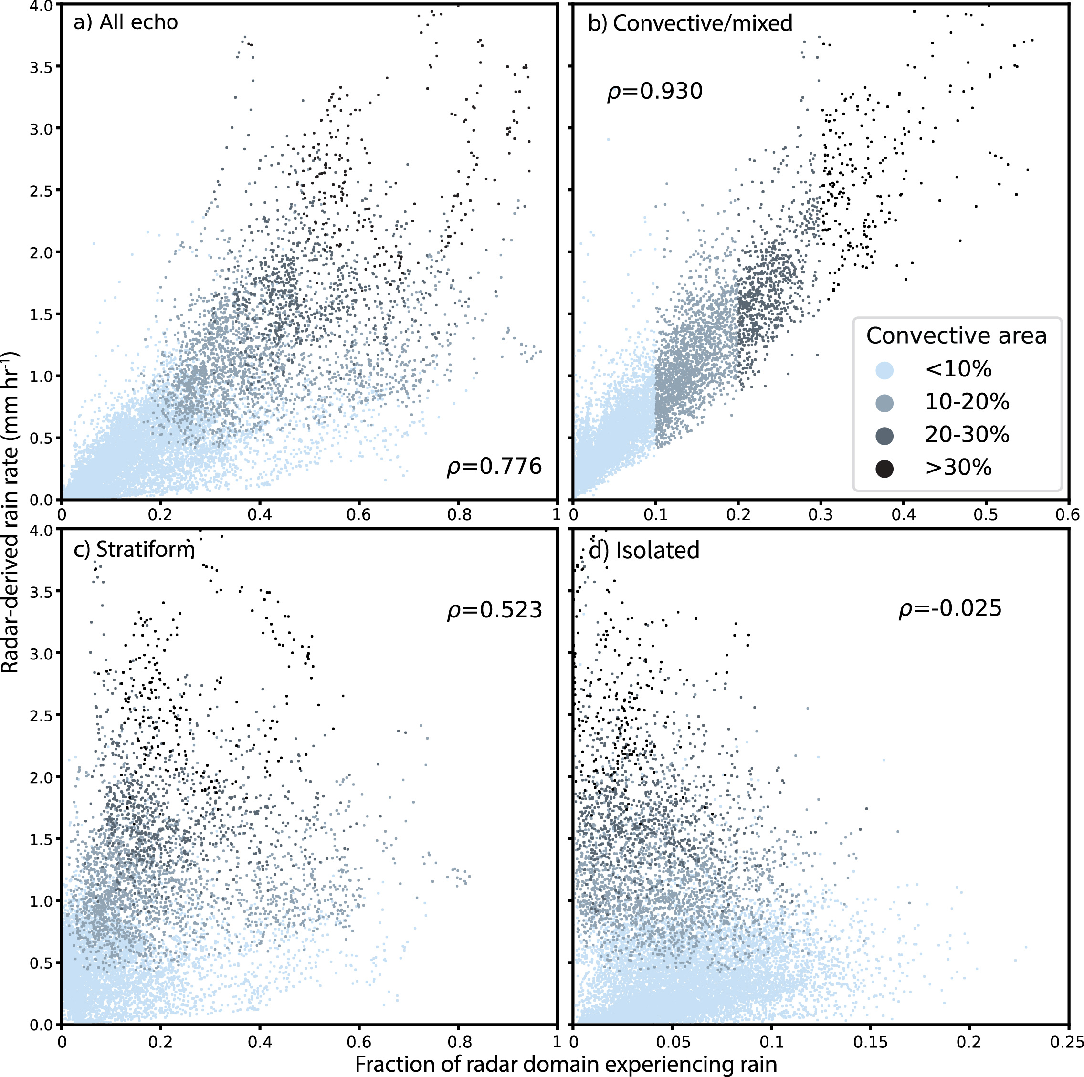
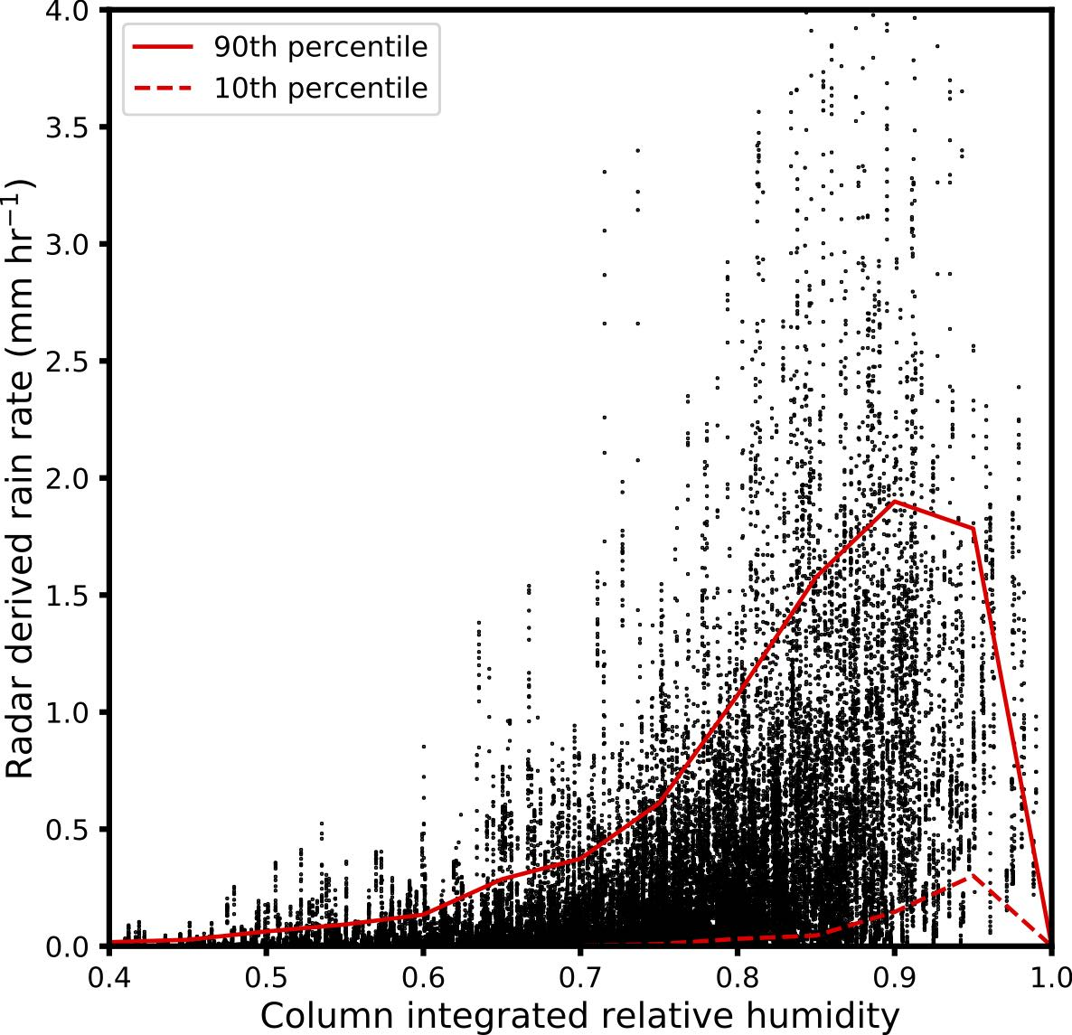
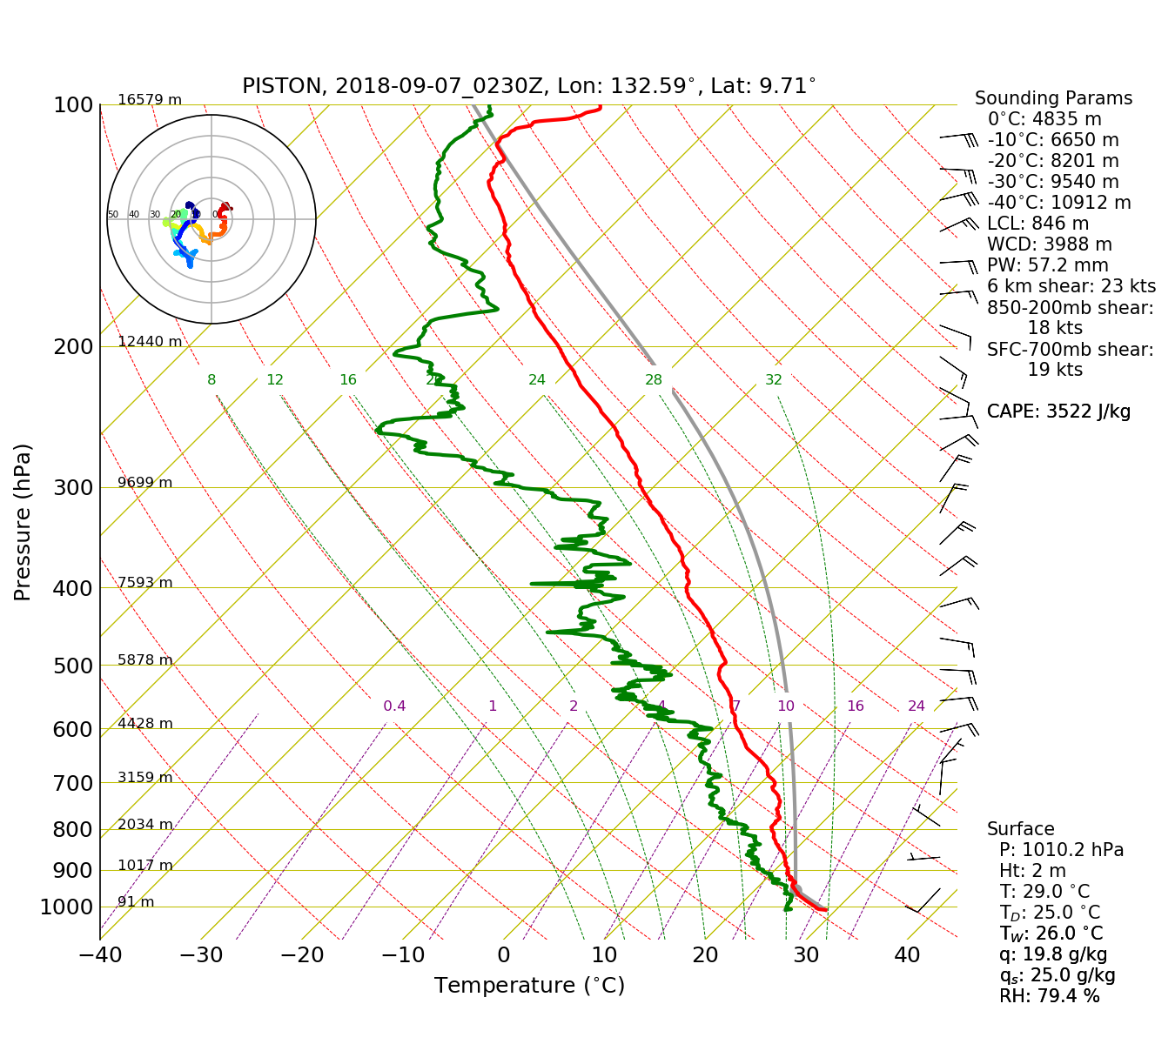
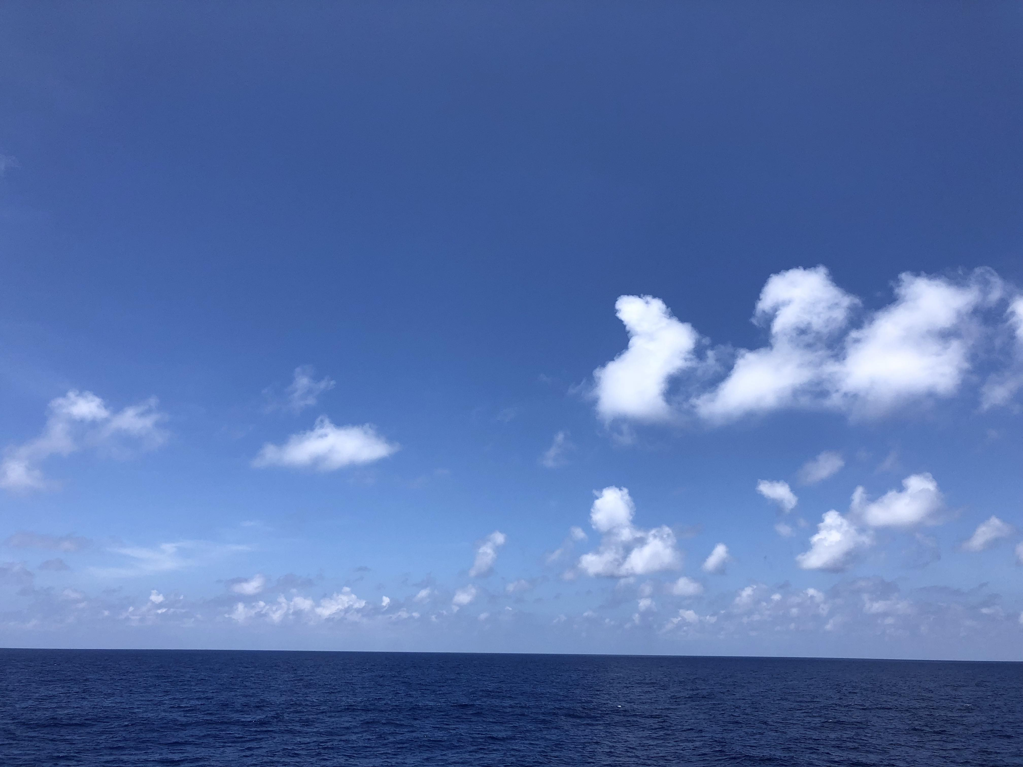
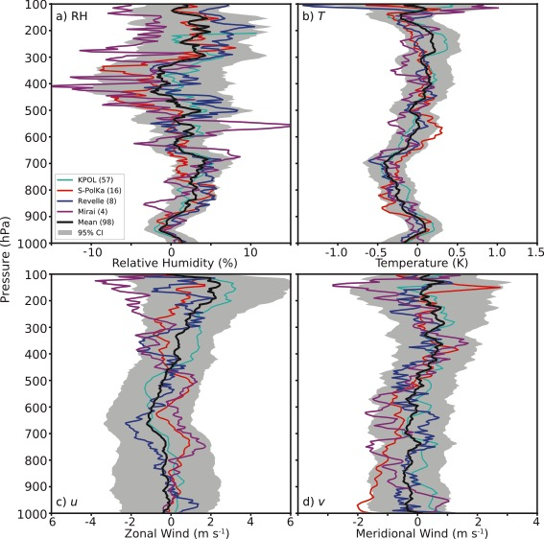
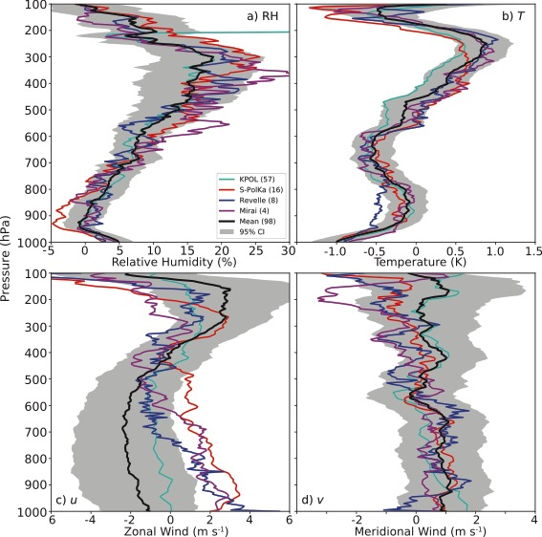
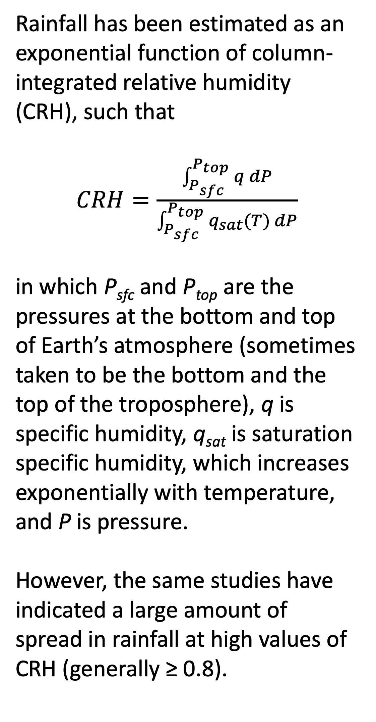
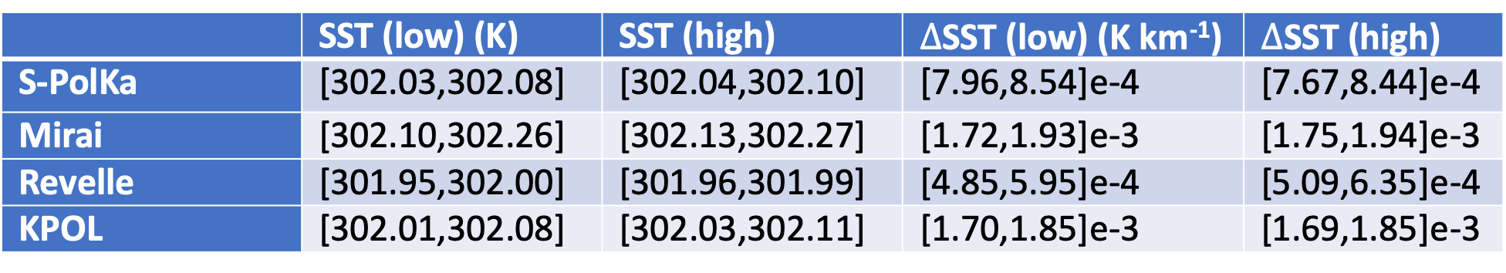
Inhibition of Tropical Maritime Rainfall in Moist Environments
Scott W. Powell, Naval Postgraduate School, Monterey, CA
1. Introduction
2. Radar Data
Dependence of tropical maritime precipitation on tropospheric humidity is well understood. Many observational and modeling studies have indicated that deepening of tropical convection is most sensitive to water vapor in the lower half of the troposphere.
However, often times, little or no rain occurs when the atmosphere is very moist. Why? Some possibilities, although not all:
Increased static stability above boundary layer
Less favorable wind/shear profiles
Lower sea surface temperature or gradient
Less boundary layer convergence
Unfavorable cloud properties, such as cloud size or vicinity of updraft to edge of cloud and environmental air
I utilized radar data from three locations. Three datasets were collected during DYNAMO in the central Indian Ocean, and one is the NASA KPOL radar at Kwajalein Atoll. S-PolKa and KPOL were/are dual-polarized. The radar data were used to estimate rain rate.
Left: Locations of radars used so far in this study.
Rain-type classification was run on the reflectivity data, and rain rate was computed using dual-pol data if possible.
3. Visualizing the Question
4. Areal Coverage of Precipitation vs. Rain Rate
Rainfall has been estimated as an exponential function of column-integrated relative humidity (CRH), such that
$CRH=\frac{\int_{P_{sfc}}^{P_{top}}{q dP}}{\int_{P_{sfc}}^{P_{top}}{q_{sat}(T) dP}}$
in which P_{sfc} and P_{top} are the pressures at the bottom and top of Earth’s atmosphere (sometimes taken to be the bottom and the top of the troposphere), q is specific humidity, q_{sat} is saturation specific humidity, which increases exponentially with temperature, and P is pressure.
However, the same studies have indicated a large amount of spread in rainfall at high values of CRH (generally ≥ 0.8).
Top, left: CRH vs radar-derived rain rates. The red lines denote the 10th and 90th percentiles of rain rate as a function of CRH.
Bottom: Picture taken from R/V Thompson during PISTON on 7 Sept 2018 at 0230 UTC.
Top, Right: Sounding from 0230 UTC 7 Sept 2018.
Left: Radar-derived mean rain rates as a function of the fraction of the radar domain experiencing precipitation (reflectivity ≥ 7 dBZ). In panels a, b, c, and d, respectively, areal coverage of all echo, convective echo, stratiform echo, and isolated echo is plotted. Darker shades of blue indicate higher area coverages of convective rainfall. The rain rates shown occurred only when CRH exceeded 0.8.
Not surprisingly, a positive correlation existed between areal coverage of rainfall and domain-mean rain rate. However, even when areal coverage exceeded half the domain (panel a), rain rate ranged from near 0 to near 4 mm hr-¹. On the other hand, radar-derived rain rate was strongly correlated with the fraction of the domain experiencing convective rainfall.
The part of the convective lifecycle (e.g. early convective or mature stratiform) observed in the radar domain is one factor in the spread of rain rates at high CRH. If echo covers half the domain, but all of the echo is stratiform, then radar-domain mean rain rate will be small. However, sometimes total areal coverage is near 0. What causes little to no echo to occur when CRH is high?
5. Environmental Characteristics
6. Radar Echo Characteristics
Rawinsonde data were co-located with each of the radar datasets. I used these data to compute kinematic and thermodynamic properties of the troposphere. Rawinsonde data was matched with radar data collected within 1.5 hours of launch.
What characteristics of the cloud population control convective depth? For example, how far from the clear-air environment must a typical tropical updraft be to become a deep convective updraft, and how does this vary with environmental conditions? How does that distance depend on environmental characteristics or the size/shape of radar echoes? How is rain rate related to the size and number of convective echoes? What controls these properties of convective echoes? The below figures do not answer these questions, but provide a first step toward that goal.
Top: Mean sounding profiles during upper quartile of convective echo areal coverage minus mean profiles during the lower quartile when less than 10% of the domain experienced stratiform. The colored lines denote results from different sites, and the black line is the composite. Shading represents the 95% confidence interval.
Middle: Same as left but considering all echo without regard to stratiform coverage.
Bottom: Table derived from ERA-I reanalysis of SST and SST gradient at the radar site during times when echo areal coverages were less than (greater than) low and high quartiles.
Troposphere between 900–700 hPa or 800–600 hPa is less stable when more rain occurs. Relative humidity in sub-cloud layer (below 950 hPa) is also a little higher.
Mean area (size; km²) of convective echo objects vs. the number of convective echo objects observed in each radar domain when CRH ≥ 80%. Convective area is more closely correlated with the number of individual convective echoes than the size of those echoes.
Aspect ratio of isolated convective echo objects observed by S-PolKa during DYNAMO. Most echo objects are 1.5 times or more larger in along one horizontal dimension than the other.
7. Challenges
Causality is difficult to untangle using just these observations. Lag-regression of, for example, 2–4 km lapse rate against rain rate, as well as sensitivity studies in a numerical model, may help.
Observations in a deep convective regime of boundary layer eddies of temperature and humidity, and boundary layer convergence are probably required.
Rawinsondes are not representative of surrounding environment of all clouds within radar domain.
Few radar observations of shallow, nonprecipitating convection in deep convective tropical regime exist.
Difficulty identifying updrafts with single-Doppler data at S- or C-band.
Relationships between rain rate and other variables when CRH ≥ 80% is so far difficult to find.
 | SST (low) (K) | SST (high) | $∆$SST (low) (K km⁻¹) | $∆$SST (high)
S-PolKa | [302.03,302.08] | [302.04,302.10] | [7.96,8.54]e-4 | [7.67,8.44]e-4
Mirai | [302.10,302.26] | [302.13,302.27] | [1.72,1.93]e-3 | [1.75,1.94]e-3
Revelle | [301.95,302.00] | [301.96,301.99] | [4.85,5.95]e-4 | [5.09,6.35]e-4
KPOL | [302.01,302.08] | [302.03,302.11] | [1.70,1.85]e-3 | [1.69,1.85]e-3
SST and SST gradient apparently have minimal impact on rainfall at these spatial/temporal scales when CRH ≥ 80%.
Lapse rate vs. rain rate: No obvious relationship is seen.
This work is supported by Research Initiation Program funds from the Naval Postgraduate School.

